Slide 1

01 – Operating Systems and Virtual Machines
COMP 190 – Dickinson College
Fall 2021
Image from: https://www.hiclipart.com/free-
transparent-background-png-clipart-ajzax
Image from: https://www.mychoicesoftware.com/blogs/
news/why-do-so-many-companies-use-windows-os

Slide 2
COMP190 – Tools and Techniques for Software Development An introduction to the Unix command line environment, shell scripting, system administration, debugging tools and version control. Skills developed will be applied in the context of a Humanitarian Free and Open Source Software (HFOSS) project. Case studies of social, legal and ethical issues raised by computing and computing for the greater good will complement the technical skill development.
Notes:
Brief overview of course content.
High practical value of technical skills for internships and jobs
Also provide ability to make an impact on our (and other) communities
HFOSS is FarmData2

Slide 3
Notes:
Place of 190 in the overall curriculum.
On threads for:
W – writing
G – computing for the greater good
- Emphasize the socal power of computing in addition to its business value.
E – social / legal and ethical issues
S – SINE elective
- Social innovation and entrepreurship certificate.
Direct preparation for COMP 290
- Deep engagement with FarmData2 HFOSS project.
Leads to work in HFOSS or FOSS project of your choice in Senior Seminar.
Option for a 390 independent study if interested.

Slide 4
COMP 190
½ Credit
Credit / No Credit
Weekly Work
Reading and Discussion (social/legal/ethical)
Introductory Lecture
Activity Sheet (submit on Moodle)
Competent / Not Yet Competent / Resubmits
Quiz (take on Moodle)
Score 100% / Retries
Communication on Teams
https://dickinson-comp190.github.io/website/
Notes:
Credit/No Credit – no letter grade.
- learn it because it is important!
Reading and Discussions
- Short ~10min readings and 10-15 min discussion
- Come prepared to
- Say something about something you found interesting.
- Ask a question about the content
- Ask a question of your classmates (what did you think about xyz?)
Introductory Lecture
- Big picture and context
- Not everything you need to know
Activity Sheets
- Guide you through a set of experiences
- Build up your experience bank and toolbox
- Not intended that you memorize or master everything
- Instead experience it, know it exists, be able to return to it when you need it.
- This is why credit/no credit instead of letter grade.
- the more you engage it the better you’ll be able to use it
- in future classes / projects
- in internships or jobs
- Talk, Share Ideas, Ask questions… Just learn it / experience it.
Quiz
- reviews the material from lecture and activity
- Use it as a self test.
- Review things you miss and try again.
Show Teams
Show website structure

Slide 5


Questions
Image from: openclipart.org

Slide 6
Topic 1: Unix Introduction (5 weeks)
Operating Systems & Virtual Machines
Unix Command Line Interface (CLI) and Paths
Unix Tools and Filters
Shell Scripting
Basic Unix System Administration

Slide 7
The purpose of an operating system is to provide an environment in which a user can execute programs in a convenient and efficient manner. - Silberschatz, Galvin, Gagne Operating System Concepts
Notes:
Provide an environment in which a user can execute programs.
when machine starts (i.e. boots up) it is just bare hardware
That machine can run one only one program
the program it runs is the OS
the OS creates the user experience and allows us to run (execute) programs.
Convenient Manner
What is convenient depends on which user the and the context in which the OS is being used.
- perhaps point and click….
- perhaps touch screen…
- perhaps command line (Terminal)
Efficient Manner
Again what is efficient will again depend upon the user and the context in which the OS is being used.
And efficiency interacts with convenience
- if we are using memory and CPU power to make things look pretty (point and click vs text interface)
- then programs will not be able to run as fast or use a much memory.
The result is that are lots of different operating systems tailored to different environments and purposes.
- OS for a PC is different than for a mobile device is different than for a server.

Slide 8

PC Operating Systems
Tux
Three primary ”flavors”
Target user convenience (point and click)
Also support “power users”
e.g. computer scientists, developers – us!
MacOS X
Windows
Unix / Linux
Image from: https://www.cleanpng.com/
Notes:
We ill be focused on using a PC operating system as that is where the majority of software development occurs.
As you are likely familiar with MaxOS and Windows this course will use a Linux based OS.
- This is also because a lot of software development happens on Linux / Unix
- Particularly in the cloud where Linux has up to 70% market share.
Familiarity with the way Unix/Linux operate and the tools they provide will be valuable to you

Slide 9








What is Linux
Linux is an umbrella term that refers to a huge array of Unix compatible operating systems that are built on the Linux kernel.
Linux comes in many “flavors” (i.e. “distributions” or “distros”)
Images from: https://www.cleanpng.com/
Notes:
Kernel is just the core parts of the software that make up the OS.
”Flavors” refers to distributions, which is just a way of saying that a particular group is making it available.
You’ll hear people say things like – ”I’m using the Ubuntu distribution” or “distro” for short.
Fedora, Red Hat, SUSE, gentoo, Ubuntu, Debian, ArchLinux, Puppy Linux
And probably hundreds of others.
You will get familiar with one flavor in this course Linux Lite

Slide 10
Why/How So Many Distros?
The Linux kernel was created as Free and Open Source Software (FOSS).
FOSS
Not only cost free…
but source code is also freely available…
and four freedoms are guaranteed. You are:
Free to run and use it for any purpose
Free to redistribute it
Free to study and modify it
Free to redistribute it with modifications
Notes:
FOSS – More on this later in the course.
But basically, once those freedoms were established
It allowed lots of different groups to customize Linux to their purposes or philosophies
- desktop, servers, embedded systems, mobile devices, old resource constrained PCs
- If you have a set of requirements you can likely find a Linux distro to meet them.
- and if not, you can take the source code and customize it yourself.
MacOS and Windows are proprietary and not FOSS
- this is why there is only one “flavor” of each of those
- note: flavor is different than version

Slide 11

We will be using the Linux Lite distribution in this class.
“Simple. Fast. Free.”
Simple: Designed for transition to Linux
Fast: Relatively low hardware requirements
Free: Both FOSS and zero cost
Active and up to date
Derived from major Linux distribution (Ubuntu)
Notes:
The first set of activities will have you installing and doing some basic tasks with Linux Lite.

Slide 12
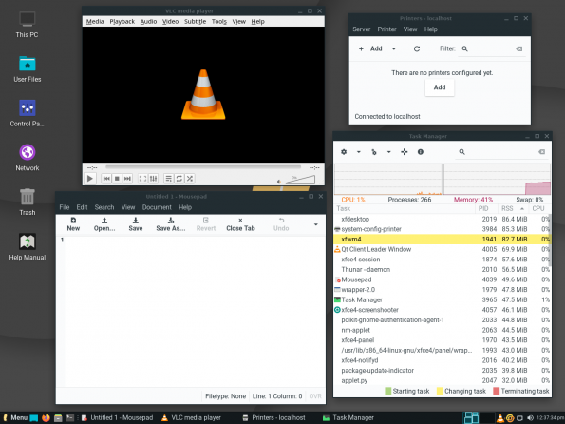
Notes:
Experience you’ll have is much the same as with windows or mac
It looks a little different, but really its no more different than Mac is from Windows.
Windows, Menus, Icons, Dock, etc…

Slide 13
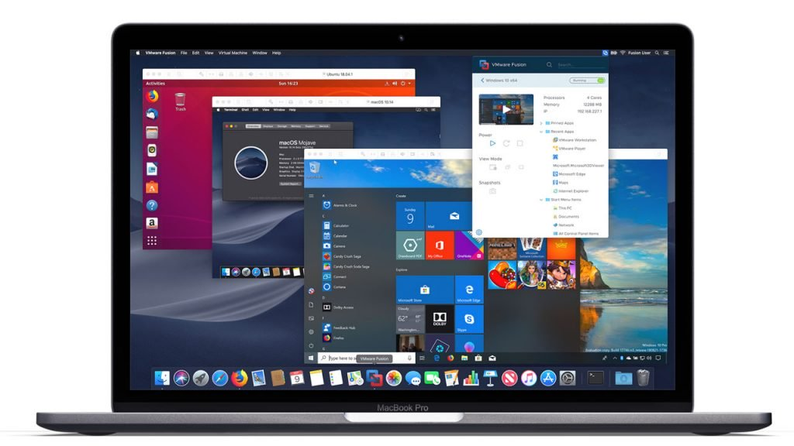
Virtual Machines
A virtual machine (or VM) is a piece of software that, when run, behaves as if it is another complete computer.
Image from: https://www.thurrott.com/windows/windows-10/
176235/vmware-workstation-15-and-fusion-11-are-now-available
Notes:
Here is a mac running 3 virtual machines.
One running Linux,
One running a (possibly) different MacOS version.
One running windows.
So four complete computers each running its own OS.

Slide 14
Virtual Box
We will be using VirtualBox in this class.
VirtualBox is FOSS
You will
Install VirtualBox on your computer or use a lab computer.
Install Linux Lite on a VM in VirtualBox.
Why a VM?
Easier install
You will have administrative privileges
Protects your machine
Resettable
Image from: https://www.hiclipart.com/free-
transparent-background-png-clipart-ajzax

Slide 15
What’s Next?
Complete Pre-Course Survey
Complete 01-OSVM Activity Sheet
Convert to PDF
Submit to Moodle by Wed 12:00 noon
Read Syllabus – post questions to Teams
Complete Syllabus Quiz (Moodle)
Complete Q01 (Moodle)
Notes:
Work on 01-OSVM Activity for the rest of the class.
Use teams or office hours to ask questions of me and your classmates outside of class.

Slide 16

Acknowledgments:
Slide Template From:
https://creativecommons.org/licenses/by/4.0/
Slide Content Licensed as:
https://creativecommons.org/licenses/by-nc/4.0/

